Slide 1
We Got Heart
Employee Giving Campaign

Slide 2

We Got Heart History
Since 2002 We Got Heart has helped foster a culture of philanthropy at Phoenix Children’s.
Extends the care we provide to patients, families, colleagues & the community through personal gifts.
Signals vote of confidence from community.
Builds brighter future for patients.
Opportunity for employees to give back to a cause that is near and dear to our hearts, Phoenix Children’s!
Over $7 million has been raised through this campaign to support Phoenix Children’s programs and areas of care.

Slide 3

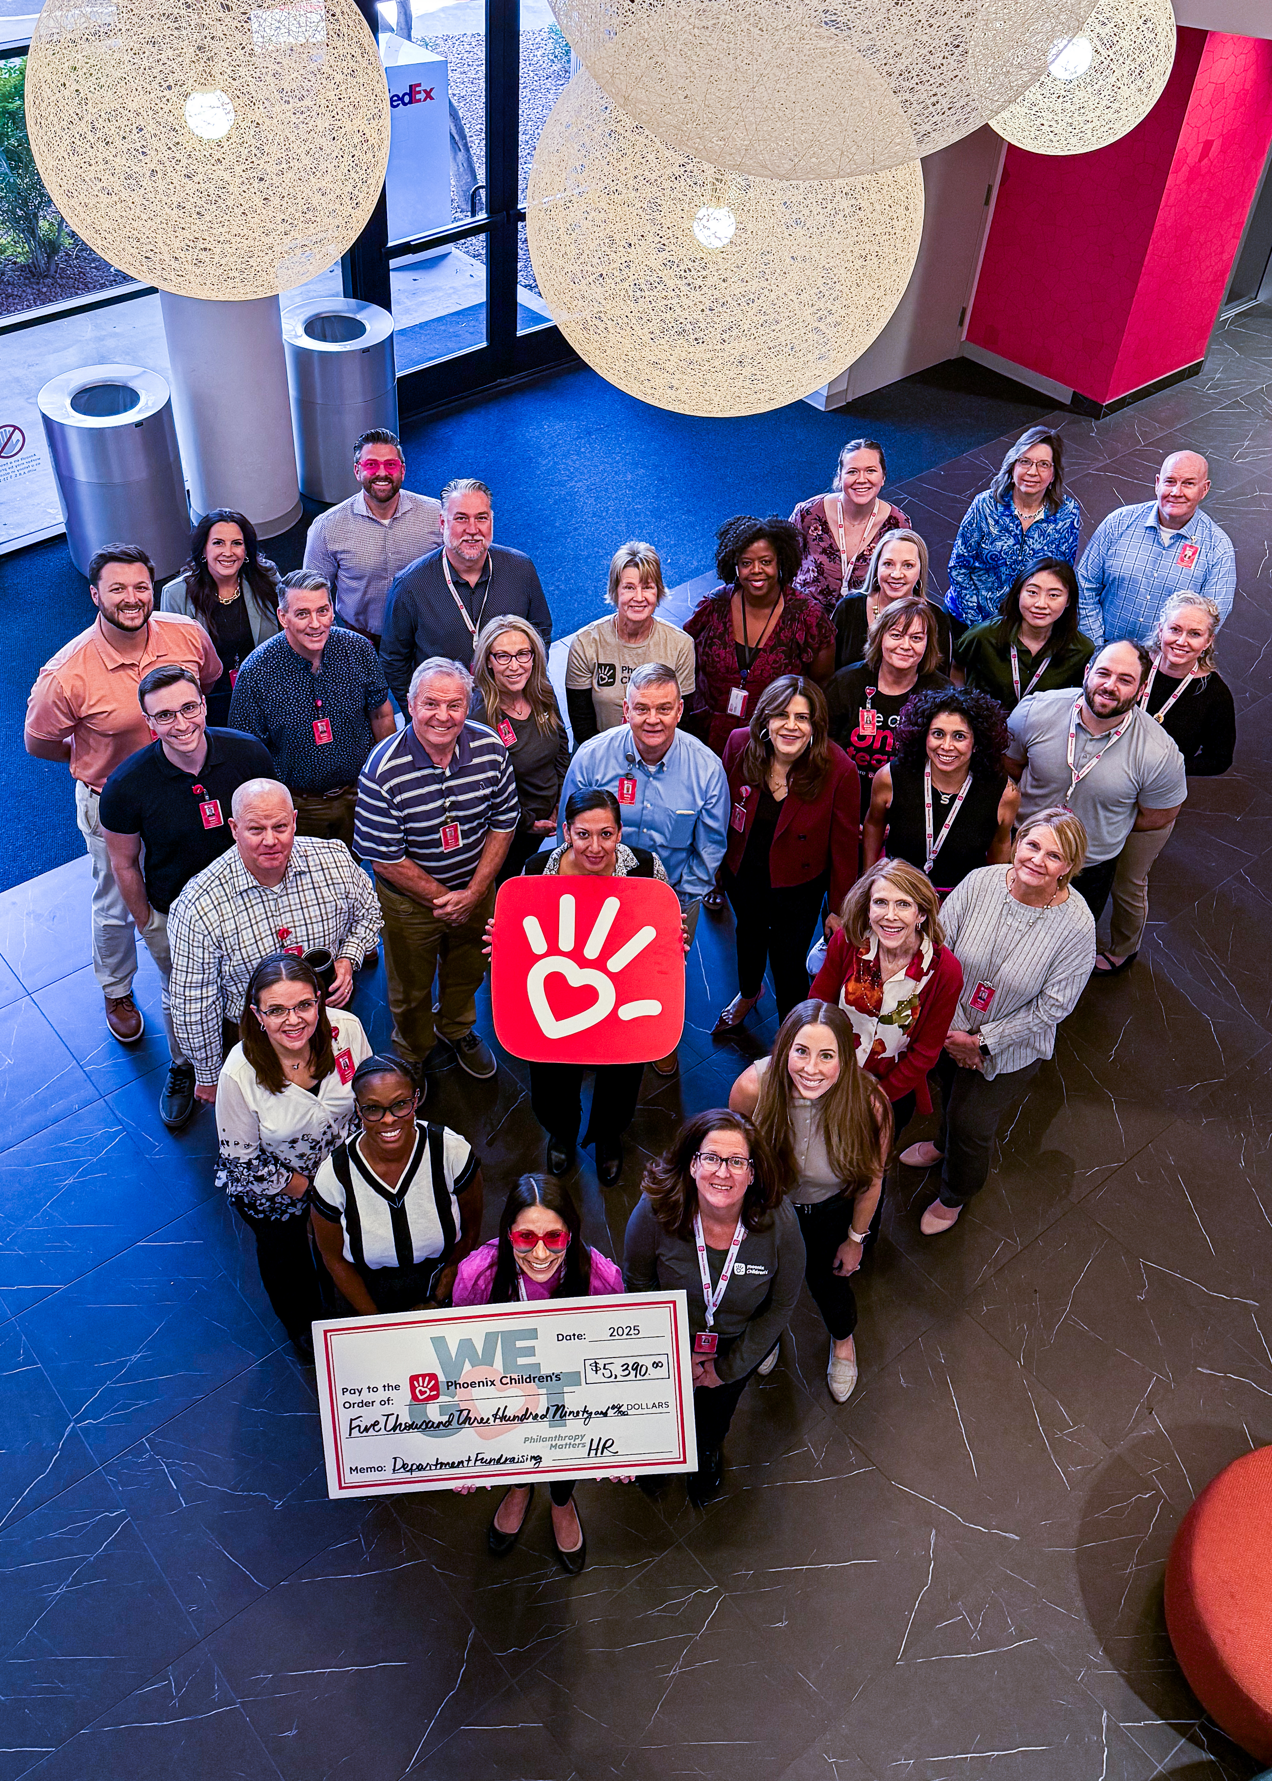
2025 Campaign Recap
Over 30% participation across all departments & sites
  47 Departments hosted fundraisers
    Top Department Fundraising Events:
Over $608,000 raised!
133 Funds supported
  Top 10 funds supported:
Physician Recruiting, $5,390
Human Resources, $4,961
Physician Revenue Cycle, $3,618
Sodexo – EVS, $2,260
Clinical Research Admin, $2,062
Hospital Medicine, $1,739
Medical Staff Services, $1,160
Foundation, $1,061
Urology, $875
Graduate Medical Education, $680
Phoenix Children’s Care Network, $616
Hope Fund, $151,184
Homeless Youth Outreach, $29,631
Patient & Family Hardship, $21,535
CCBD, $21,190
Hospital Medicine Division Fund, $14,191
Radiology Research & Education, $14,109
Animal Assisted Therapy, $13,537
Cardiology, $12,240
Child Life, $12,137
NICU, $11,823
23 Departments with
100% participation!

Slide 4
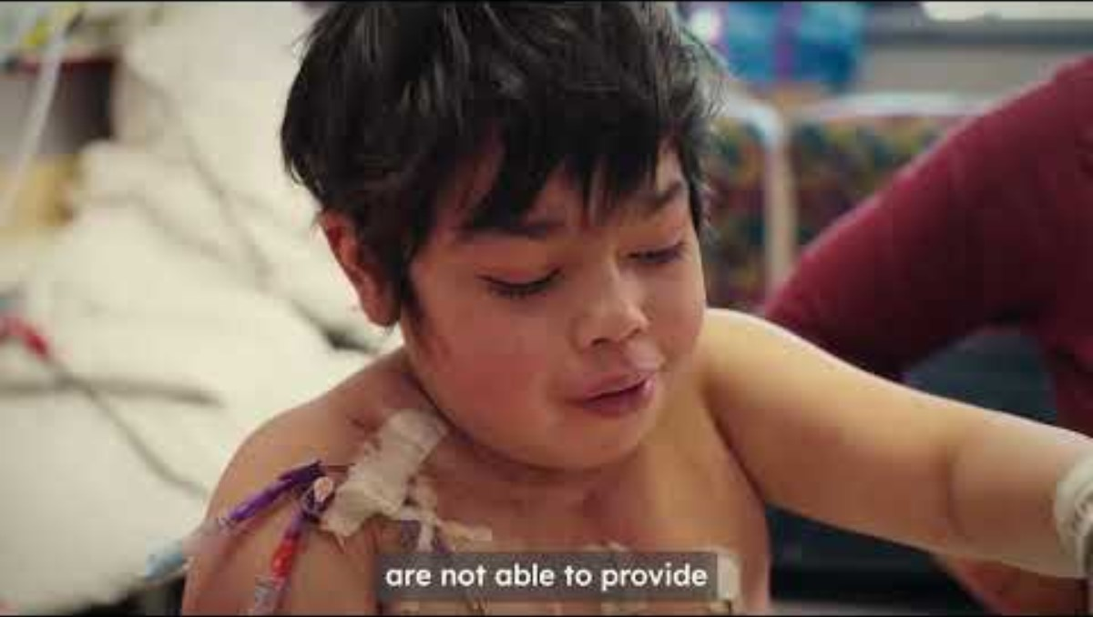

Slide 5
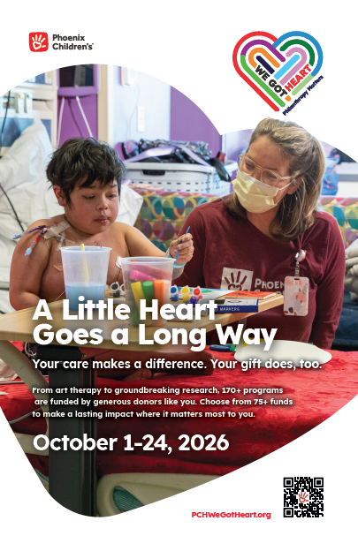
2026 We Got Heart Campaign
Philanthropy Matters
  “A Little Heart Goes a Long Way”
October 1-24, 2026
Choose the fund you support
  Direct your gift where it matters most to you!
Featured Fund
The Hope Fund is a critical source of funding for the areas of greatest need. It helps us respond immediately to urgent needs and invest in state-of-the-art technology, innovative clinical trials, family-centered care and more.

Slide 6
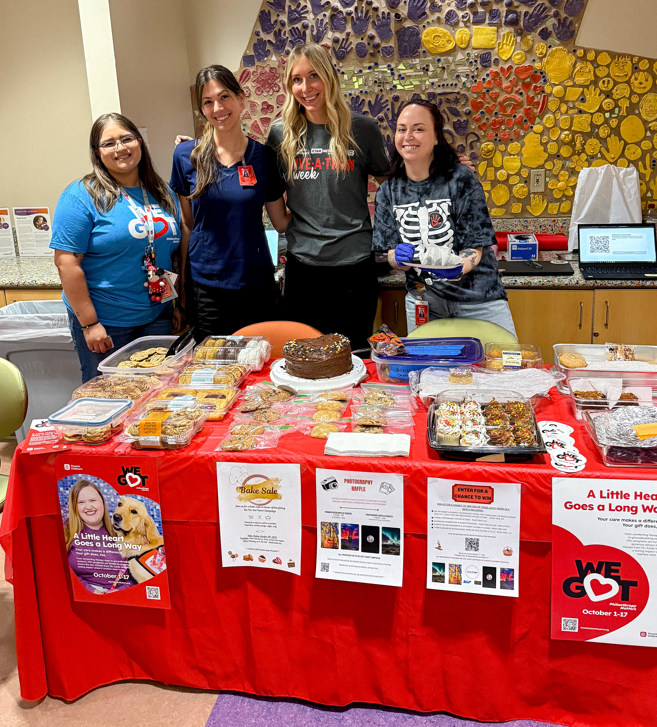
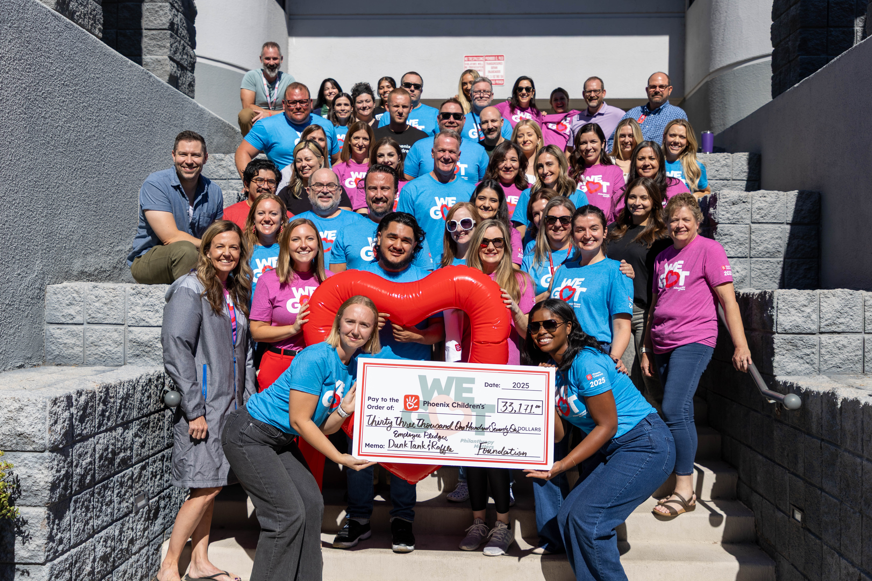
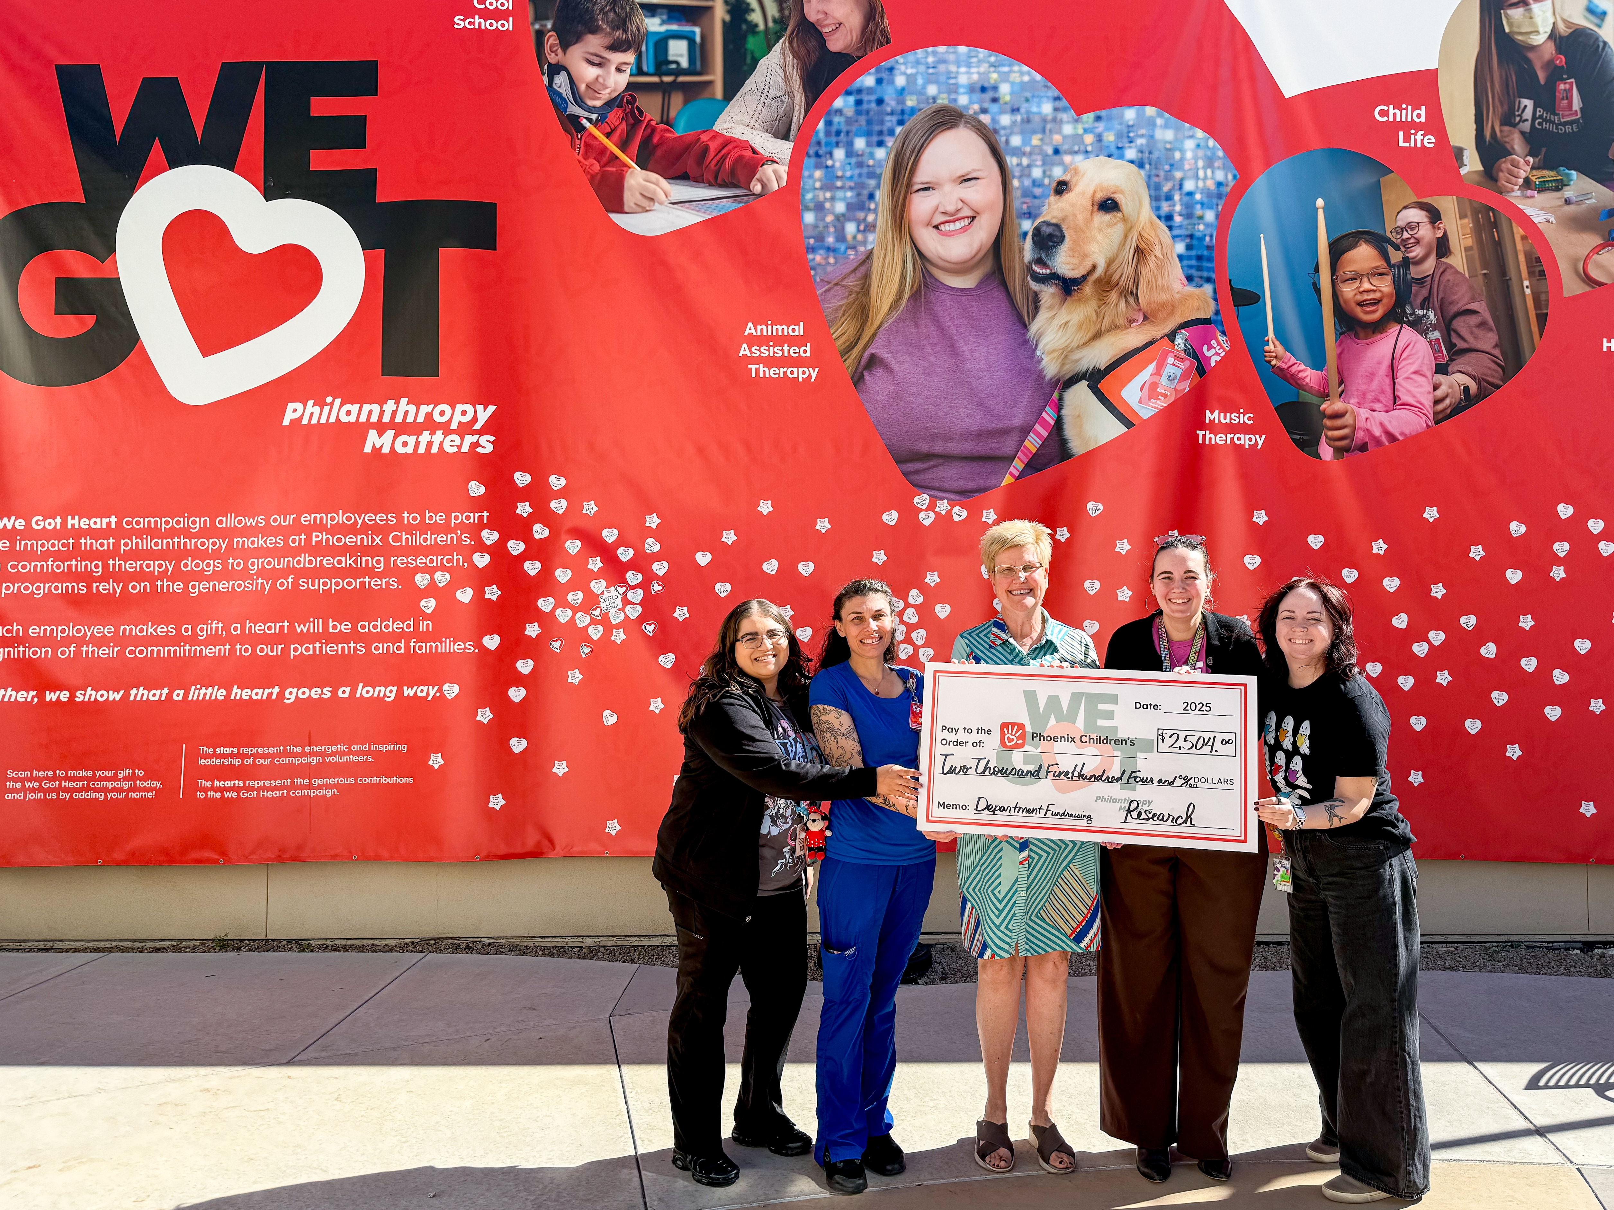
2026 We Got Heart Campaign
“I give to the We Got Heart Campaign because I truly believe in the mission of the organization. While I could donate to other community organizations, I see the direct impact of my donation to Phoenix Children’s on patients and families every day.”

Slide 7
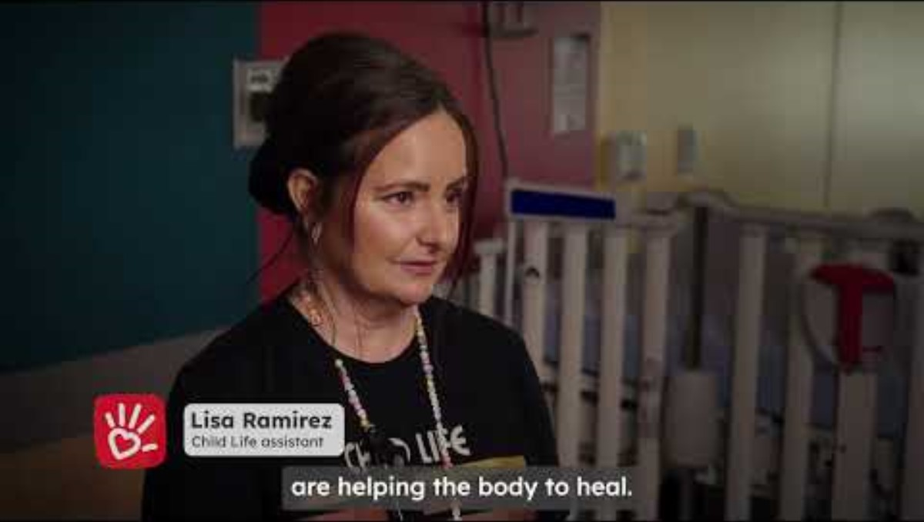

Slide 8
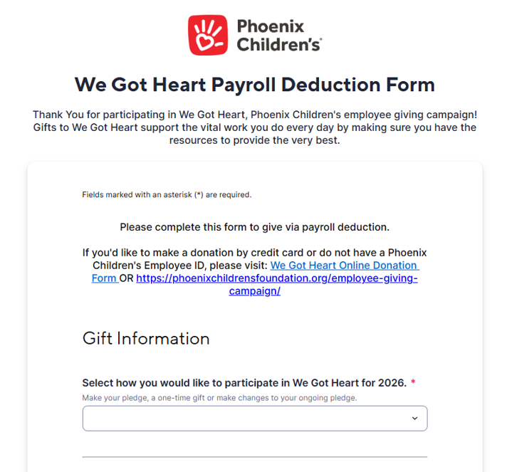
Ways to Give
Payroll Deduction
  Recurring Payroll Deduction
    Choose an amount to have deducted from your check each pay period
    New pledge deductions begin January 2027
    Auto-renewal option
    Reminder of renewal will be sent in September
  One-time Payroll Deduction
    Choose an amount to have deducted from second paycheck January 2027
  How: Complete the Smartsheet form linked on the campaign landing page. Information is automatically passed along to Payroll.
The simplest and most popular way to give!

Slide 9
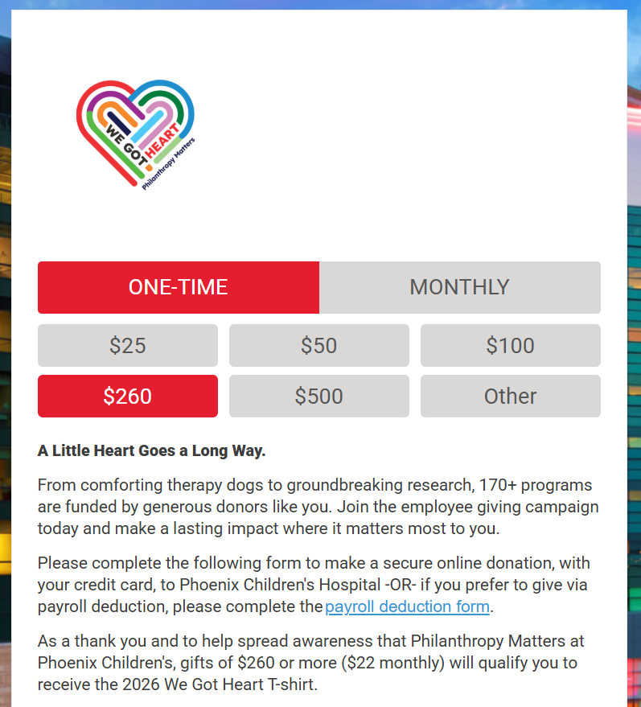
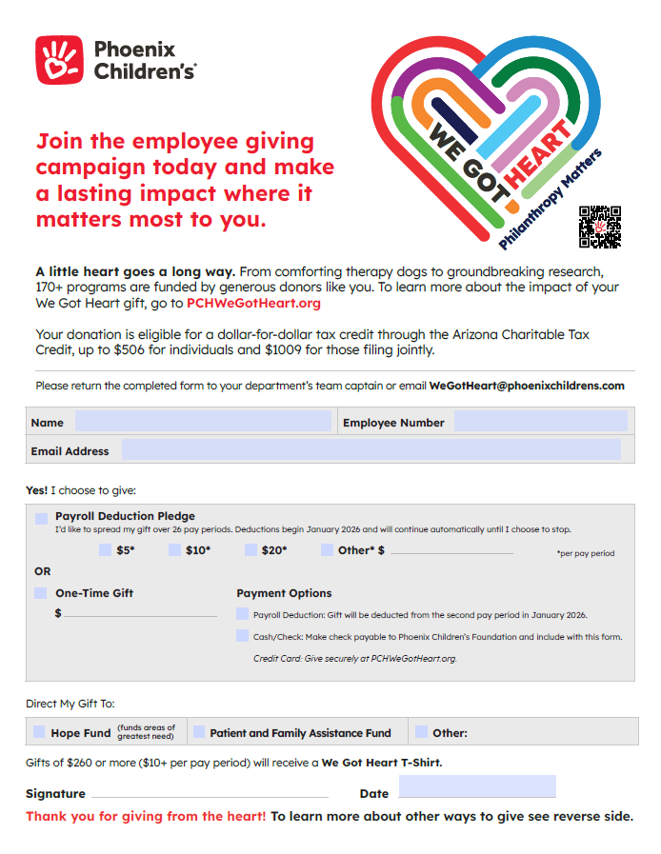
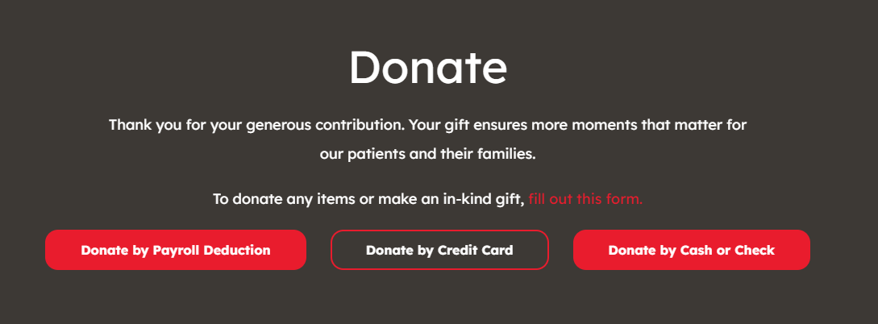
Ways to Give, continued
Other Ways to Give
One-time or Monthly Gift
  Website www.PCHWeGotHeart.org
  Credit card, PayPal, Apple Pay, Google Pay, ACH or Venmo
  Direct Hospital Vendors, Contractors, Volunteers, etc. to this webpage.
Cash/Checks
  Downloadable Donation Form

Slide 10

Arizona Charitable Tax Credit
Give it to Phoenix Children’s, not the state.
Claim a dollar-for-dollar credit, not a deduction, for your gift on your state tax return, even if you don't itemize.
Direct your tax dollars to a cause you care about, and it costs you $0!
Up to $506 for individual filers.
Up to $1,009 for those filing jointly.
Charitable Tax Credit can be taken in addition to Arizona education credit.
To learn more, visit PCHWeGotHeart.com

Slide 11
2026 We Got Heart Campaign T-Shirt
As a thank you and to help spread awareness that
Philanthropy Matters at Phoenix Children's, employees who pledge $10 per pay period (one-time gift of $260) or more will receive a link to order a 2026 We Got Heart T-shirt!
All shirts will be mailed directly to employee’s address of their choice!

Slide 12
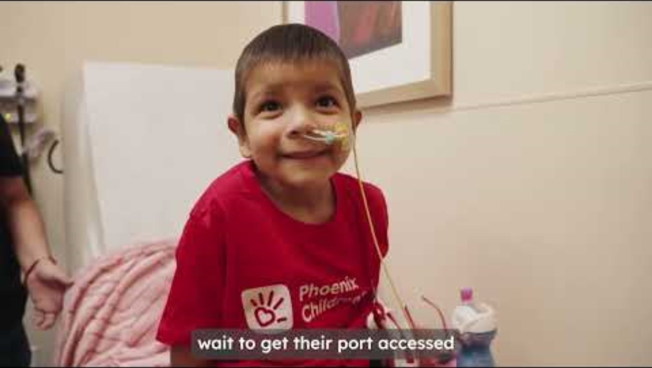

Slide 13

We Got Heart
October 1-24, 2026
QUESTIONS?
Contact your Captain or
wegotheart@phoenixchildrens.com

Slide 14
Thank you!

Slide 15


